Slide 1
Perspective on Yourself

Slide 2
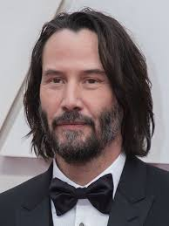
Are you doing well? Are you a good person?
How do you know if you are growing as a person who is:
Wise, reasonable and cautious
Fair and decent
Moderate, responsible and self-controlled
Emotionally and mentally strong, physically active and healthy
Generous and kind
Monotheistic religions
Soren Kierkegaard
Frederik Nietzsche
Sigmund Freud
Carl Jung
Viktor Frankl
Hannah Arendt
Karl Marx
Thomas Sowell
Robin Di Angelo
Judith Butler
Jonathan Haidt

Slide 3
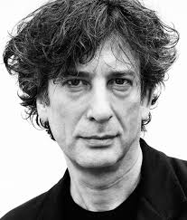
Are you doing badly? Are you a bad person?
How do you know if you are increasingly becoming a person who is:
Proud and arrogant
Greedy and selfish
Angry and vindictive
Jealous, mean-spirited and spiteful
Sexually addicted, perverted and/or exploitative
A food, alcohol and/or drug addict
Lazy and inactive
Monotheistic religions
Soren Kierkegaard
Frederik Nietzsche
Sigmund Freud
Carl Jung
Viktor Frankl
Hannah Arendt
Karl Marx
Thomas Sowell
Robin Di Angelo
Judith Butler
Jonathan Haidt

